Slide 1

Teaching and Learning

Slide 2
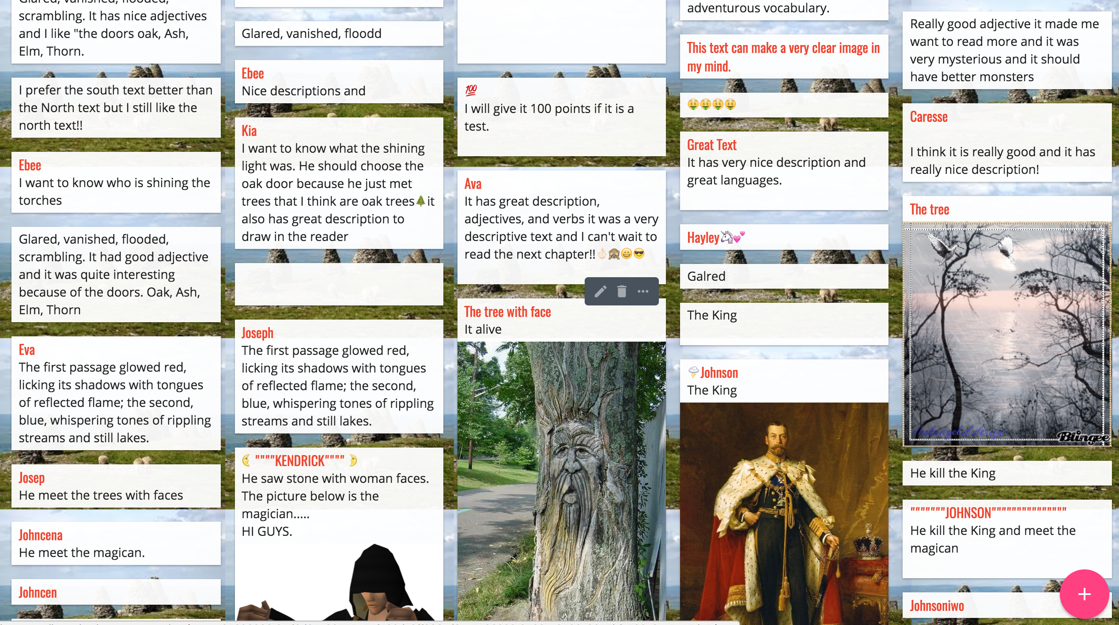
What will we cover today?
An overview of the T&L policy
Information about my role
Some practical ideas you can use in class.
Where you can find out more.

Slide 3

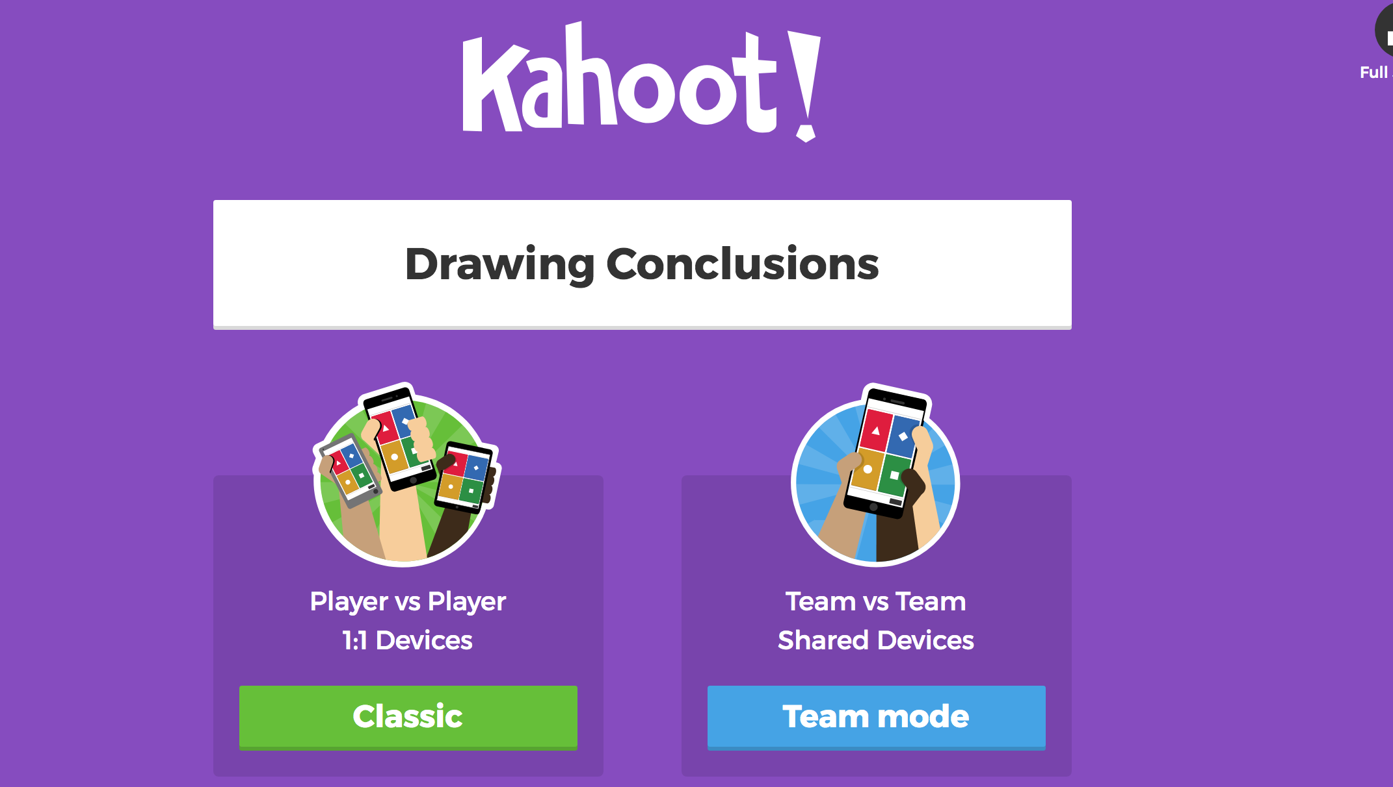
Warm Up
On ipad or laptop go to www.kahoot.it
Give yourself a ’short’ nickname – educationally based…keep it clean.
Enter Game Pin

Slide 4
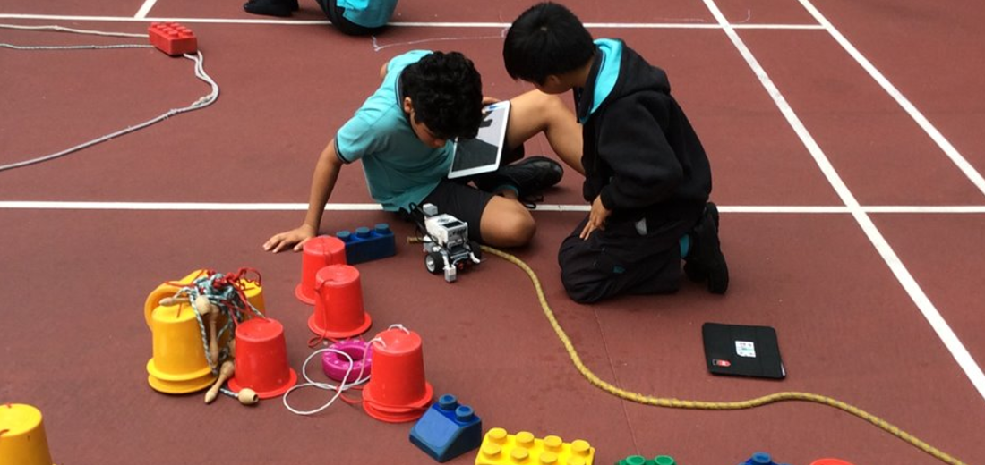
What will I be teaching????
What is the curriculum????

Slide 5
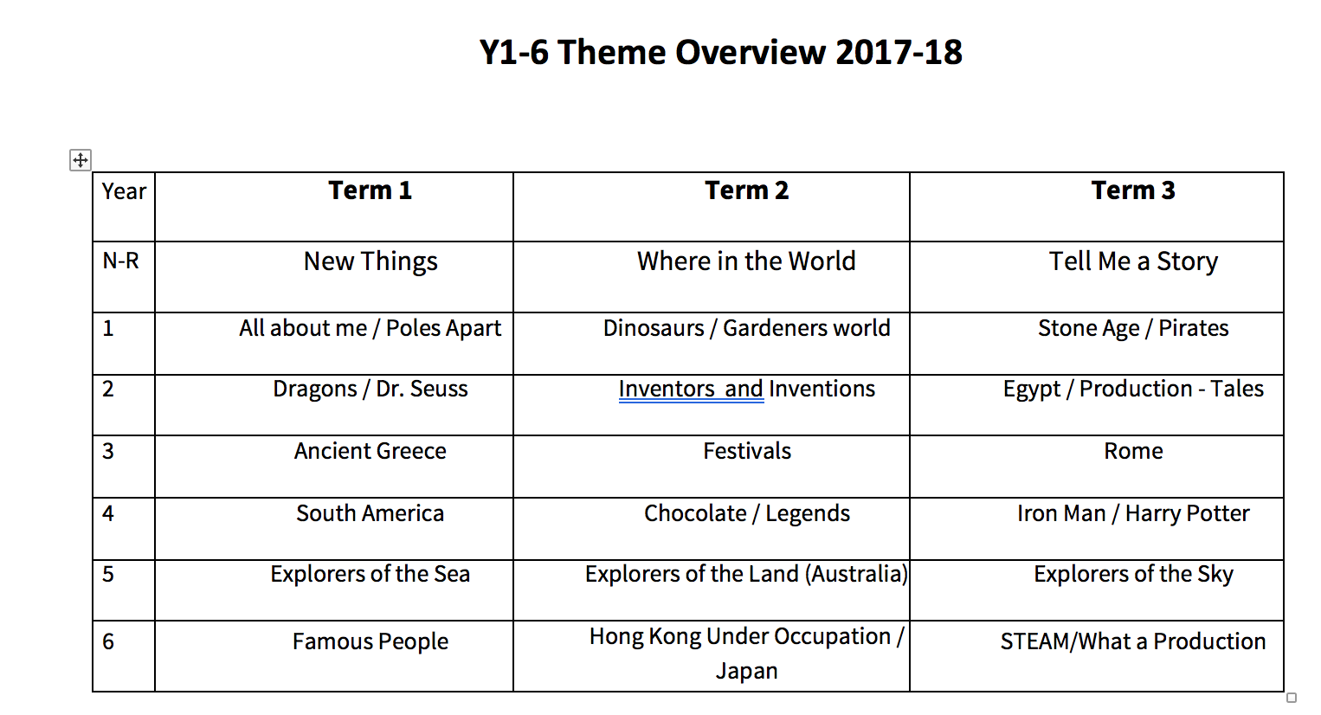
Overview Primary and Specialists

Slide 6
Head of Curriculum Role
Curriculum Coordinators for:
Primary – Science, Computing, English (x2), Maths
Secondary Head of Department - Maths, English, Science,
Specialist Heads of Department-
Drama, Music, Art, Music, PE, MFL, Mandarin
Whole school STEAM coordinator, Phonics Champion, ASN Head, Geography Champion

Slide 7

Secondary and Specialist Sources:
Server
Firefly

Slide 8
Who do you go to..?
It depends…
Y1 – 6 – Year Group Leaders are your go to people + ADH Primary
Secondary - KS3 Co, KS4 Co, ADH of Secondary
EYFS – we will all be doing it together!
Specialists – see Head of Department
New roles – check with me 1:1.
Teacher Handbooks detail all planning expectations.

Slide 9
Teaching and Learning Policy
Working in groups of no more than 3. On ipad or laptop search for nearpod on your browser.
Only use 1 device per group.
Give yourself a ’short’ nickname – educationally based…keep it clean.
Enter Code

Slide 10
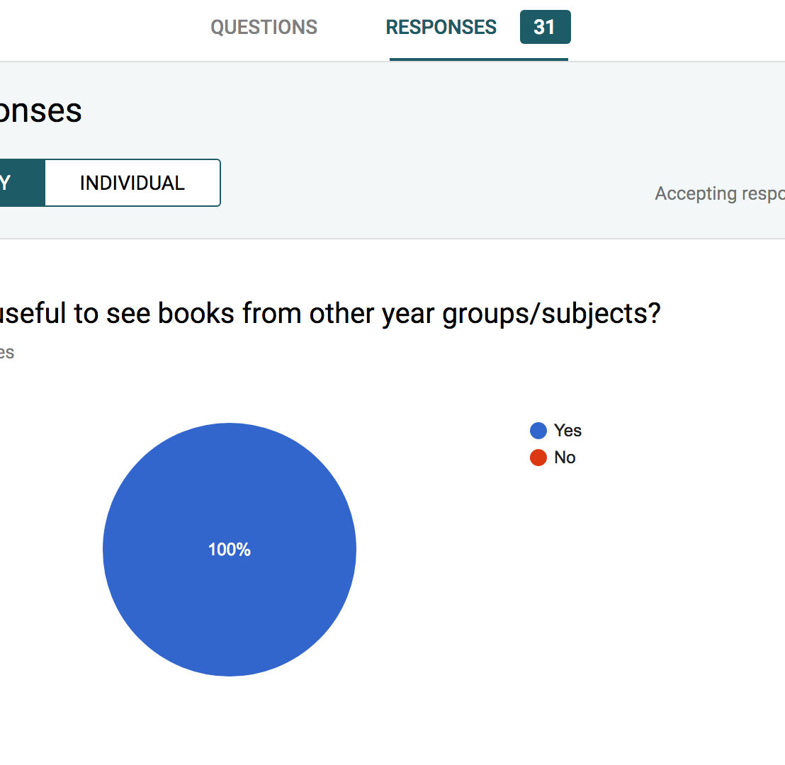
Digital feedback with Google Doc

Slide 11

Thank you

